Slide 1
SYSTEM ANALYSIS AND DESIGN
Software Development Life Cycle (SDLC)

Slide 2
Software Development Life Cycle (SDLC)
The Software Development Life Cycle (SDLC) is a structured process that enables the production of high-quality, low-cost software, in the shortest possible production time.
The goal of the SDLC is to produce superior software that meets and exceeds all customer expectations and demands.

Slide 3
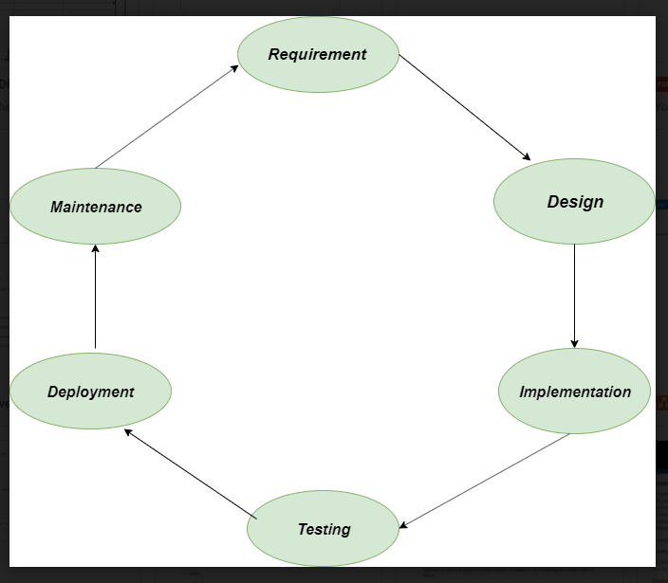
PHASES OF SDLC

Slide 4
Requirement:
In this phase all the requirement are collected from customer/client.
They are provided in a document called Businessmen requirement specification (BRS) and System requirement specification (SRS).
All the detail are discuss with customer/client in detail.

Slide 5
Design
It has two steps:
(a). High level design (HLD): It give the architecture of software product.
(b). Low level design (LLD): It describe how each and every feature in the product should work and every component.

Slide 6
Implementation
This is the longest phase.
This phase consists of Front end + Middle ware + Back-end
In front end: development coding are done even SEO setting are done
In Middle ware: They connect both front end and back end
In back-end: database is created

Slide 7
Testing
Testing is carried out to verify the entire system.
The aim of the tester is to find out the gaps and defects within the system and also to check whether the system is running according to the requirement of the customer/client.

Slide 8
Deployment
After successful testing the product is delivered/deployed to the client.Client are trained how to use the product.
Client are trained how to use the product.

Slide 9
Maintenance
Once the product has been delivered to the client a task of maintenance start.
When the client will come up with an error the issue should be fixed from time to time.

Slide 10


